Slide 1
MOBILE APP FOR APPOINTMENT ORDER
Team name : Techfires
Team members : A.Vaira mani
P.Sundara mahalingam
N.Uma maheswari
P.Kohila

Slide 2
Introduction
we have created the mobile app for appoinment order from the higher officers and doctors
Here we create an app to keep in contact with the higher officers
It provides a better way for all people commodity to get appointment
it also resolves about their full history , their achievements , their current posting and experience

Slide 3
Description
We build a mobile app to know about the higher officials
In our app we have to login our credentials or have to sign up for a new account
Then there resembles the next page
In that page we have created the list about the higher officials
Table contents comprises with the designation (i.e)doctor , police. Each official is assinged with a grade (e.g) grade A.
If we give the grades of the officials then we have the details of the official and their speciality (e.g) Doctor home page comprises with their Name,Degree,Successrate of curing ,Which area he is specialist in.

Slide 4
Example table about the officials
s.no | name | destination | grade | place
1 | N.Rakesh | doctor | A | chennai
2 | D.Yokesh | Inspector | A | chennai
3 | S.prabhu | IAS | A | madurai
4 | S.Mythili | Nurse | C | coimbatore
5 | K.Karthika | Subcollector | B | trichy

Slide 5

Doctor details
Doctor details includes
1.Name
2.age
3.sex
4.place
5.Degree
6.specialist field
7.success rate

Slide 6

Police offficer details
1.Name
2.Sex
3.Gender
4.Grade
5.Posting date
6.Retainment date
7.Experience
8.Award details
9.Suspence details
10.Transfer details

Slide 7
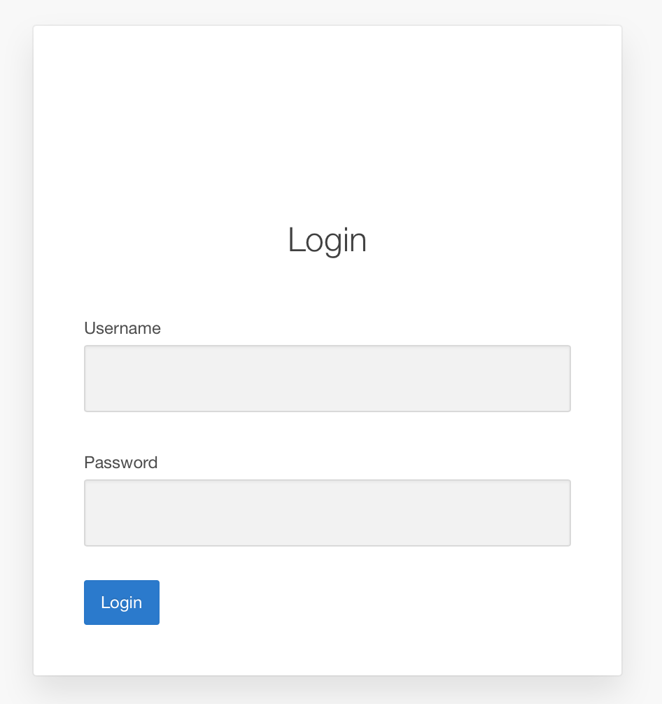

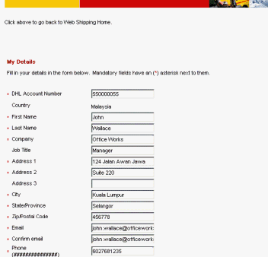
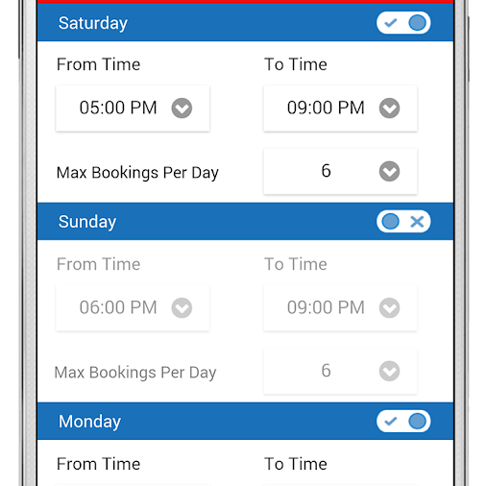
Digramatic description
Login or signup the form first
Enter the choice who they want
Display the available time of officers
Give the own details for appointment

Slide 8
Comparision with other appointment app
Our app
Other app
Appointment order for doctors,police officers,IAS
All doctors are separated by their grade
More details about officers. minimum 7 details are there
Made for india and also for others
Easy to use
Appointment order for doctors only
Doctors doesnot has any grades
Maximum 5 details about doctors are there
Not available in india
Some difficults might be there

Slide 9

Additional features
Our app helps in tracking the location of the officials
As well as tracking blood in the emergency cases

Slide 10
Technology stack
In reality more than one stacks are used for our app development. With the help of the Android Developer Tools (ADT) plugin Eclipse gains full support for Android app development.
In addition we are going to use Adobe PhoneGap / Apache Cordova with JavaScript(Frontend) or Angular JS.
Native device functionality is exposed via Javascript APIs and HTML based applications can thus access device specific functionality like sensors or camera.
For Backend, the language which will be used is SQL server or python, Java or c#, ASP net.

